Slide 1

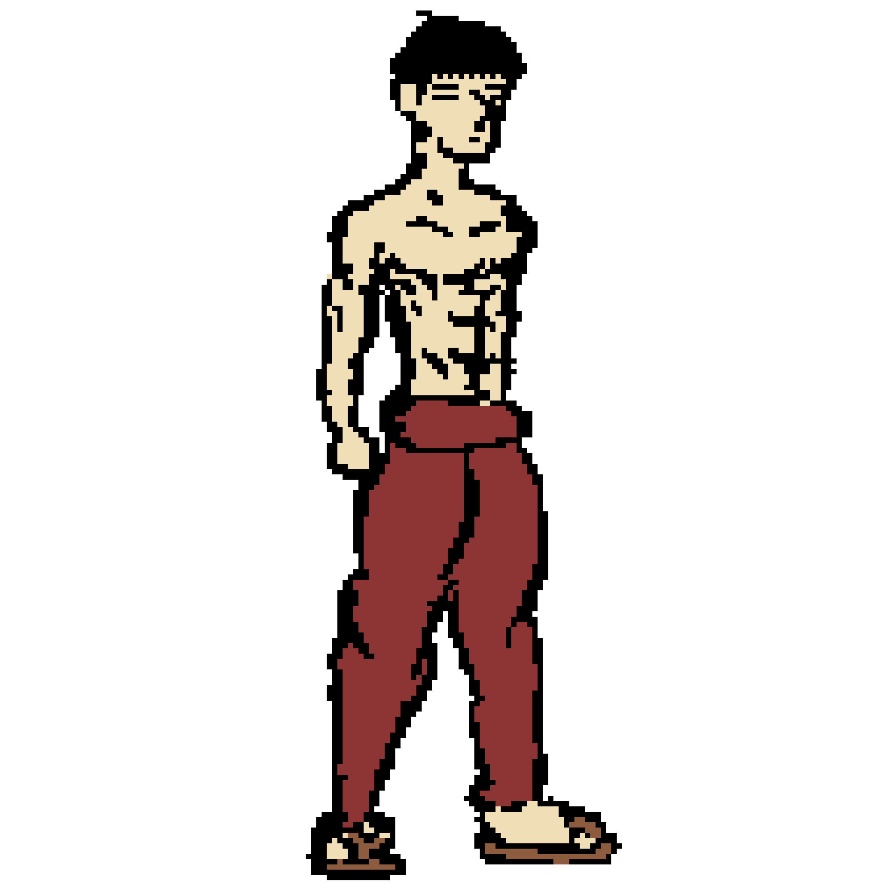
Muscle Mayhem : The Demon King’s lair
A game designed and developed by:
De Simone Tiziano
Sklodowski Marcin
Samayoa-Usher Ian Enrique
Jacobs Nathan

Slide 2
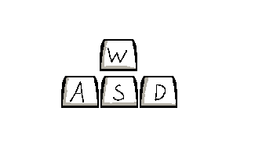

Muscle Mayhem : The Demon King’s lair
A game designed and developed by:
De Simone Tiziano
Sklodowski Marcin
Samayoa-Usher Ian Enrique
Jacobs Nathan
The Player
Bruce Wang

Slide 3
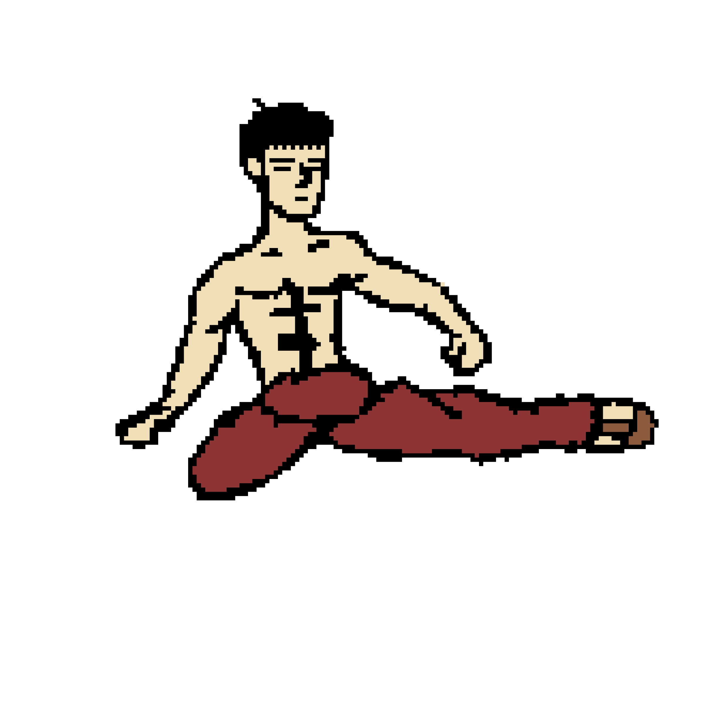
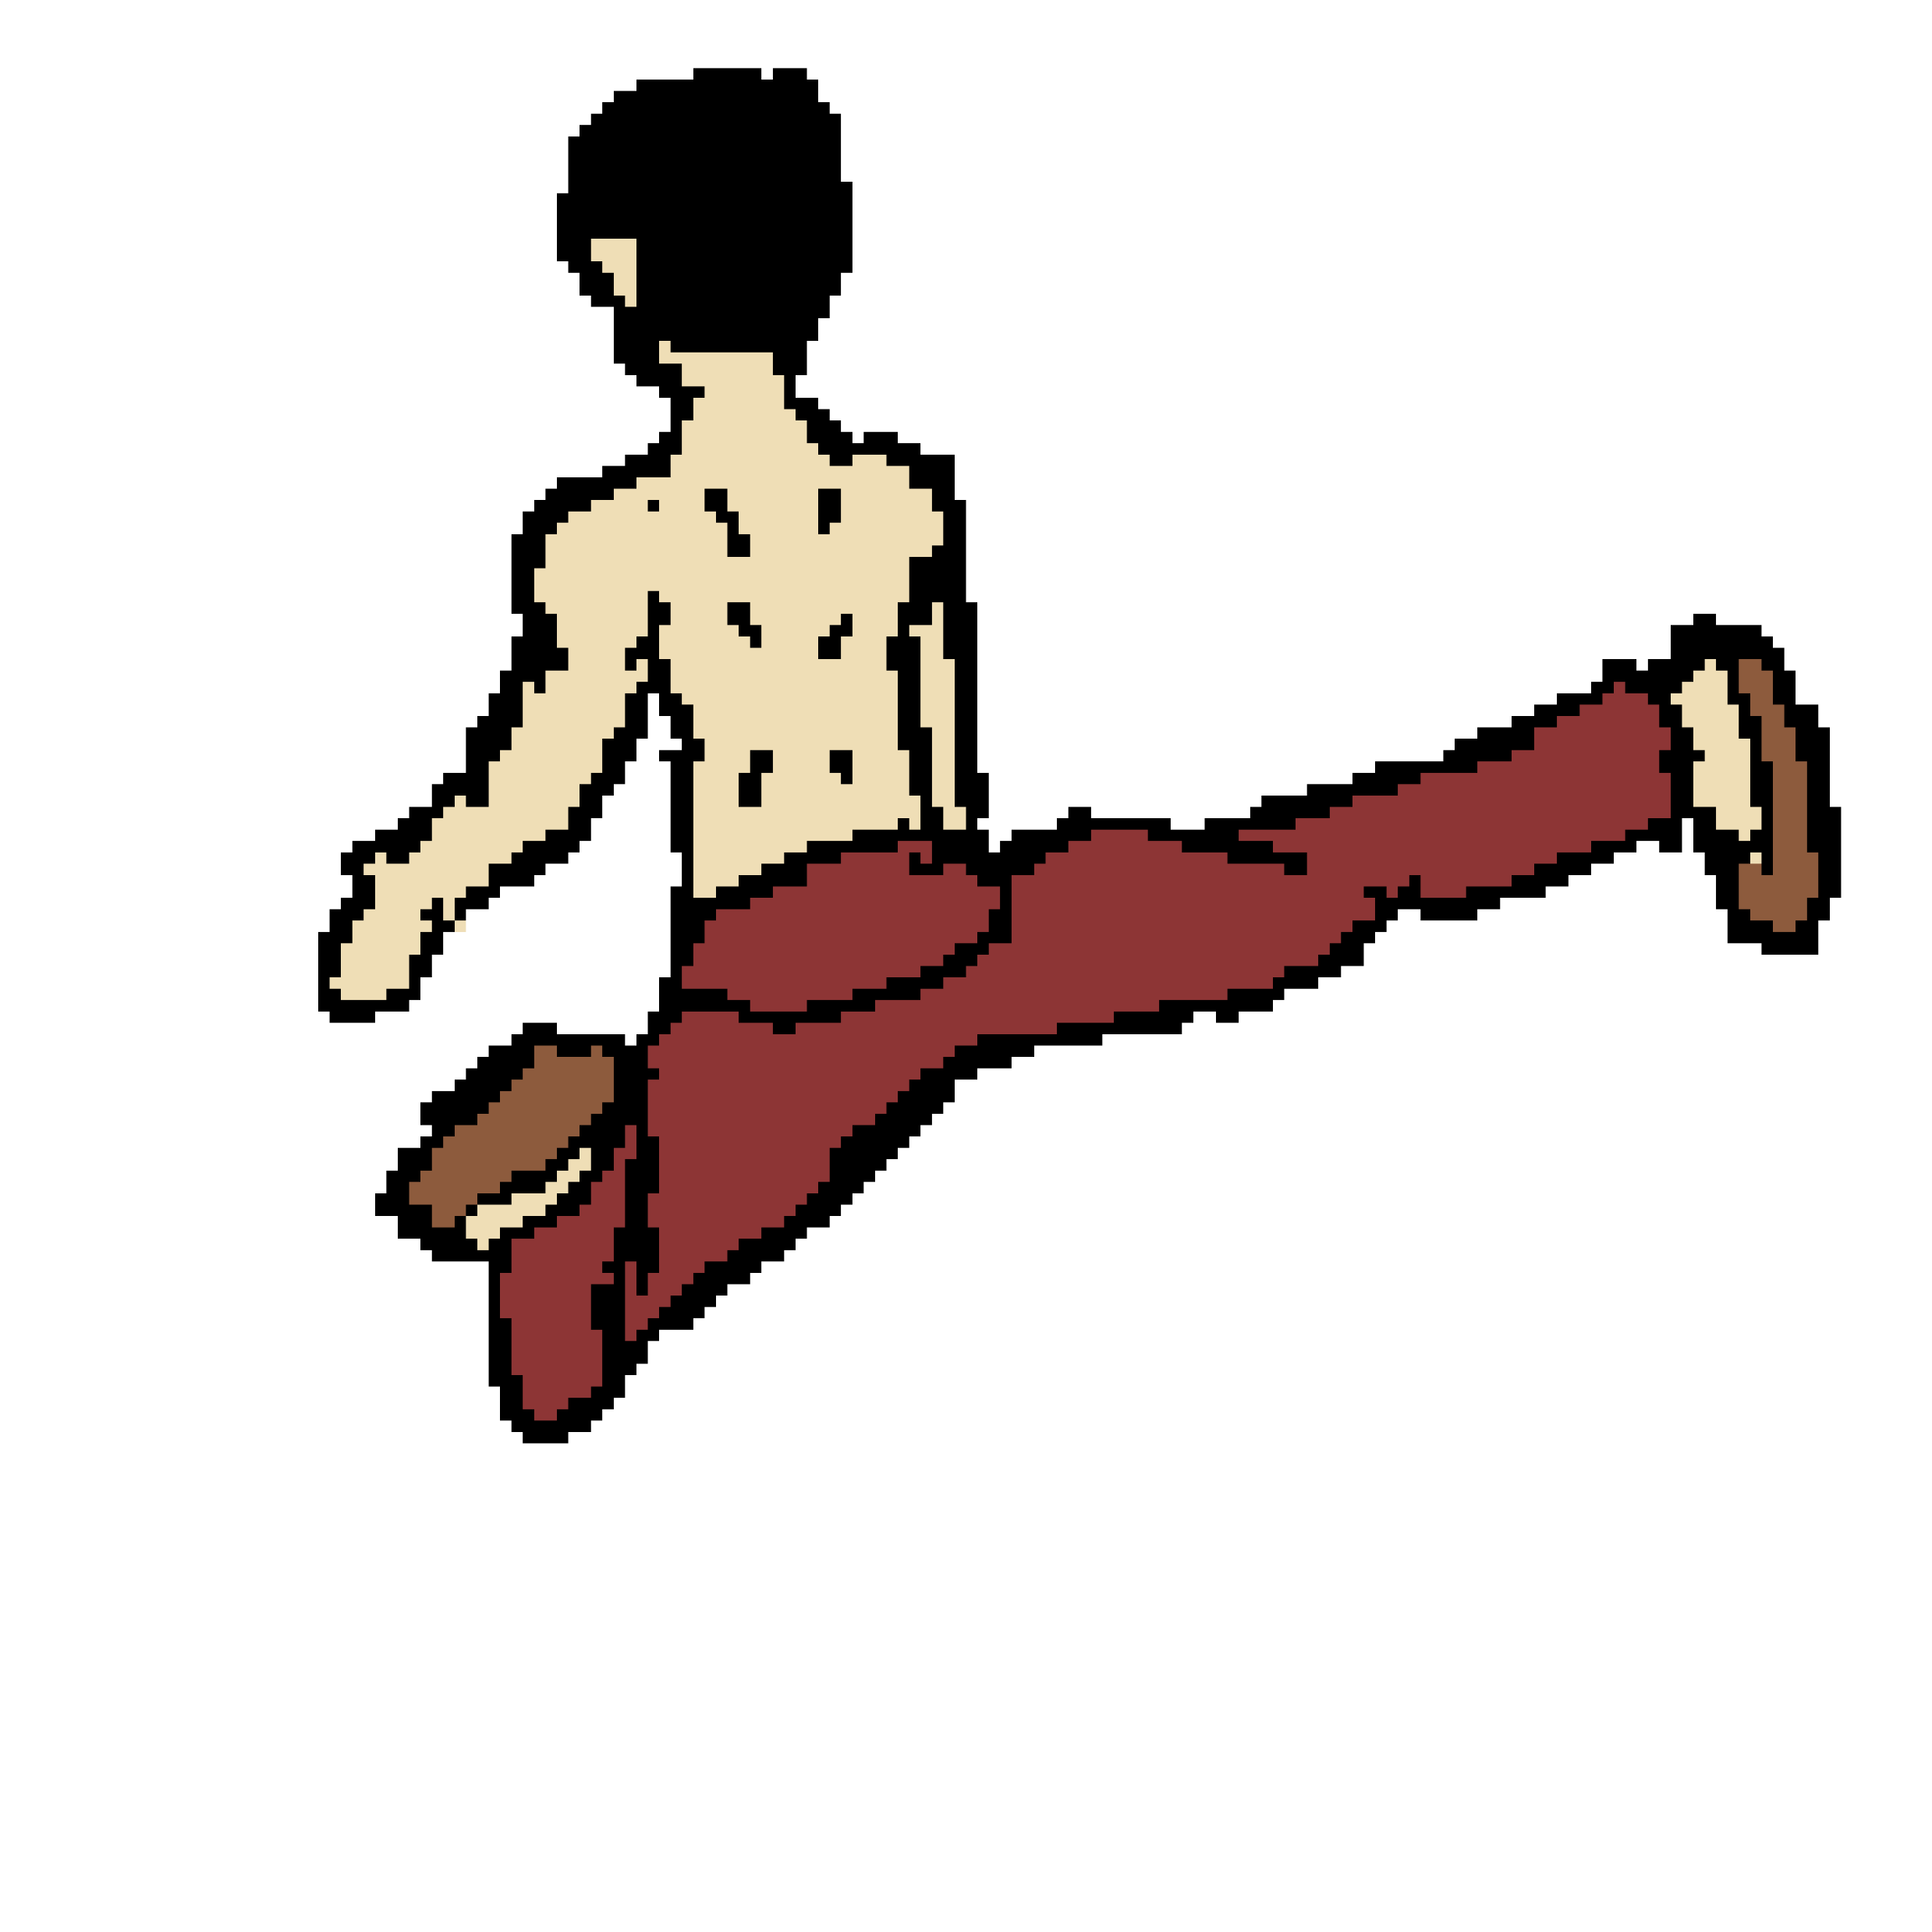
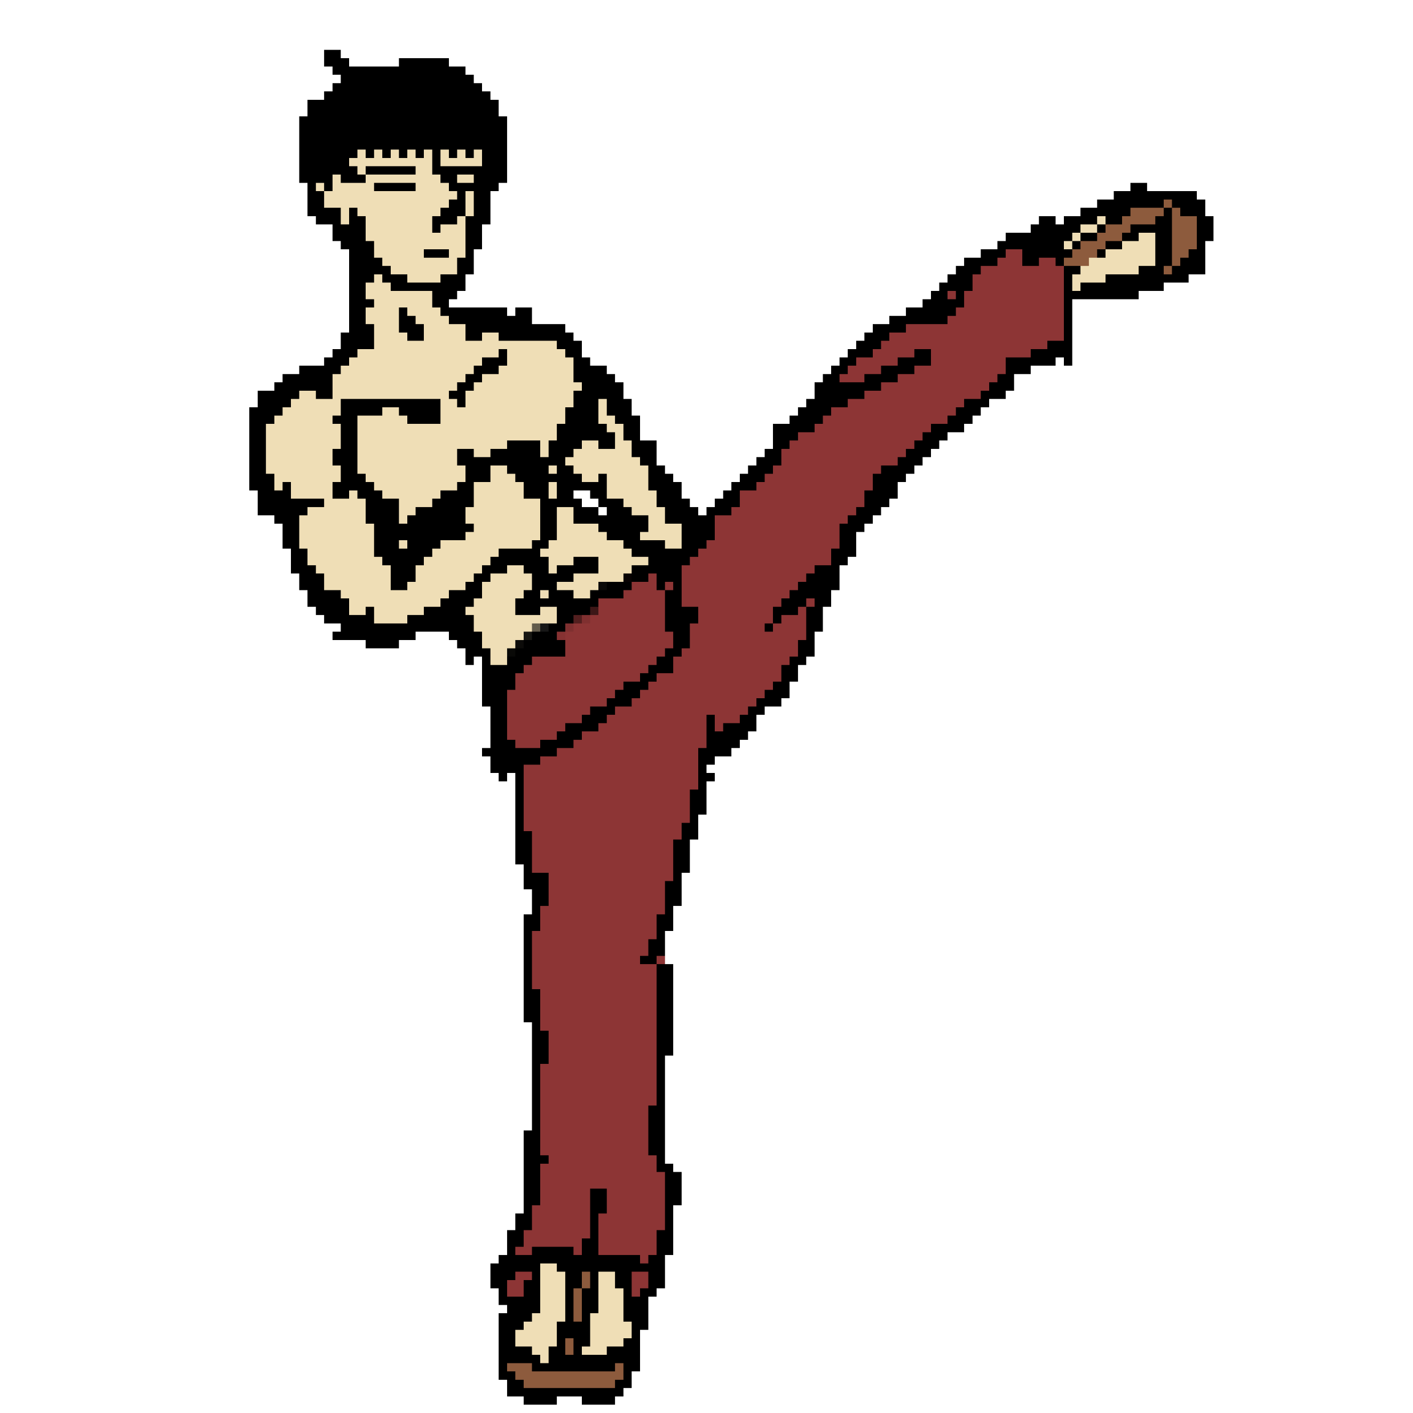
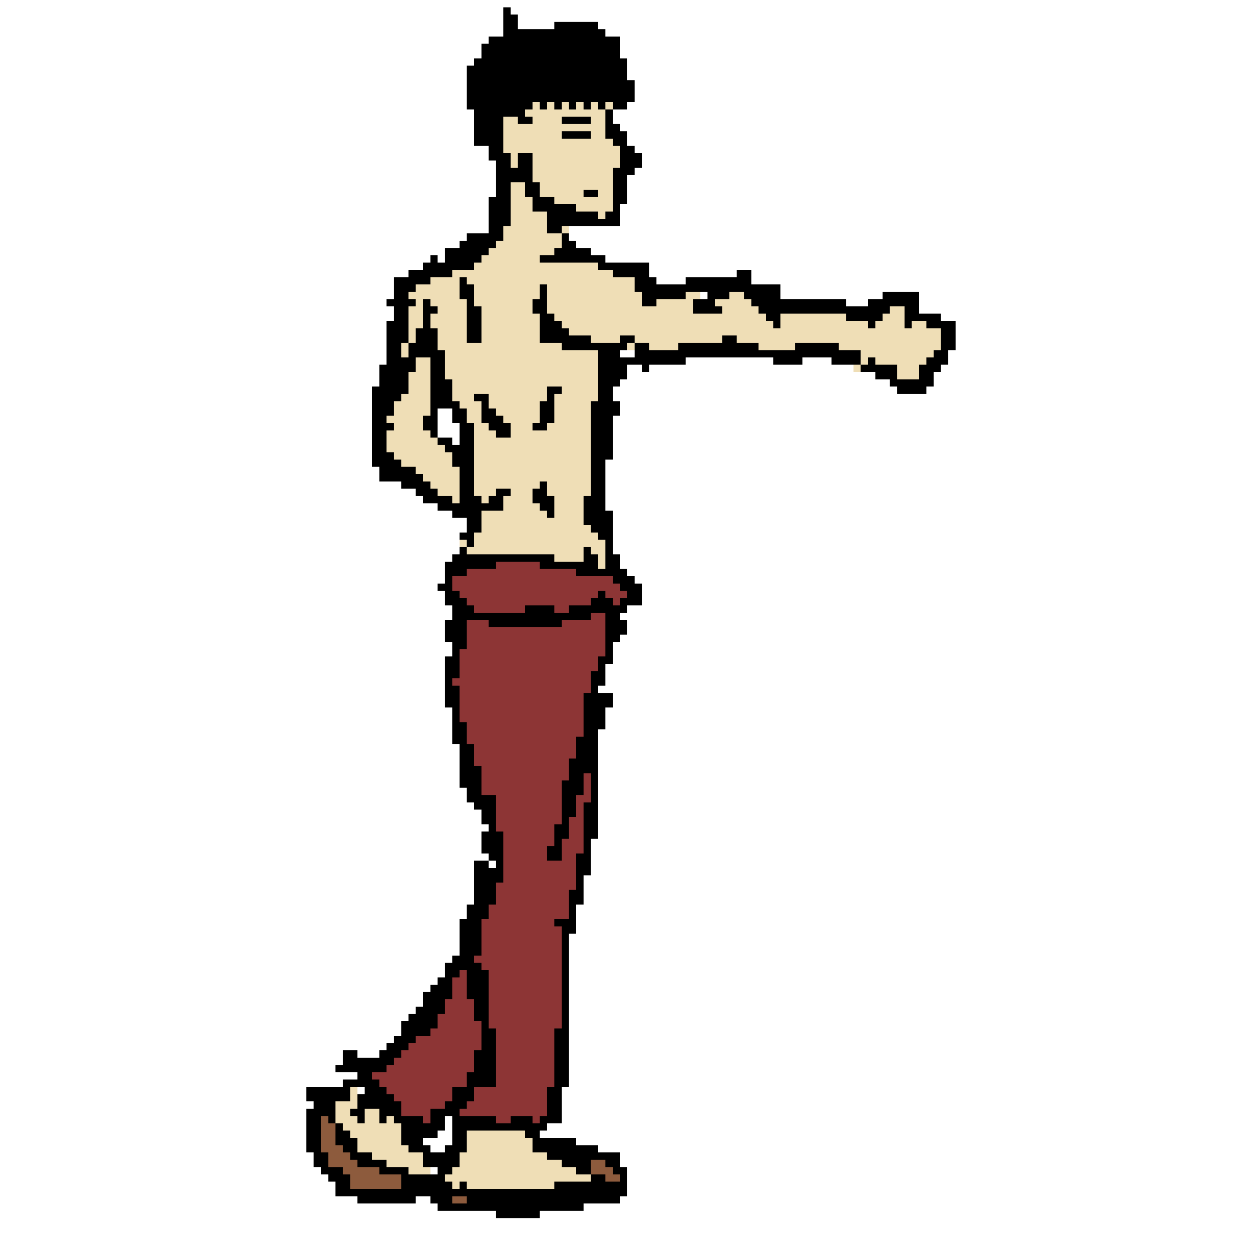
The Player

Slide 4
The Player

Slide 5

The Player

Slide 6
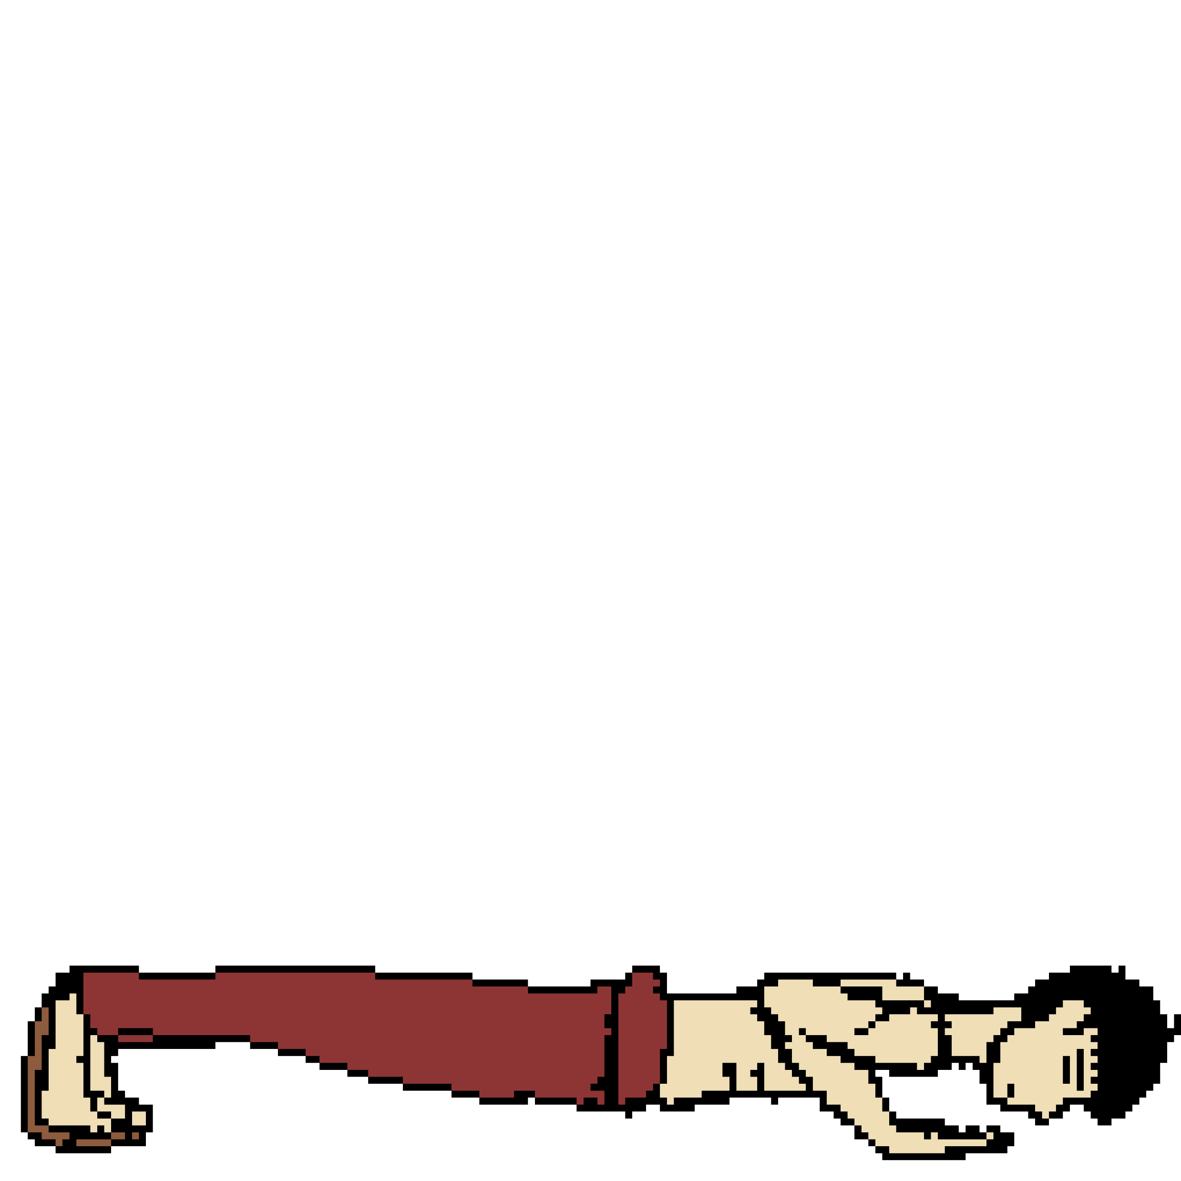
The Player

Slide 7
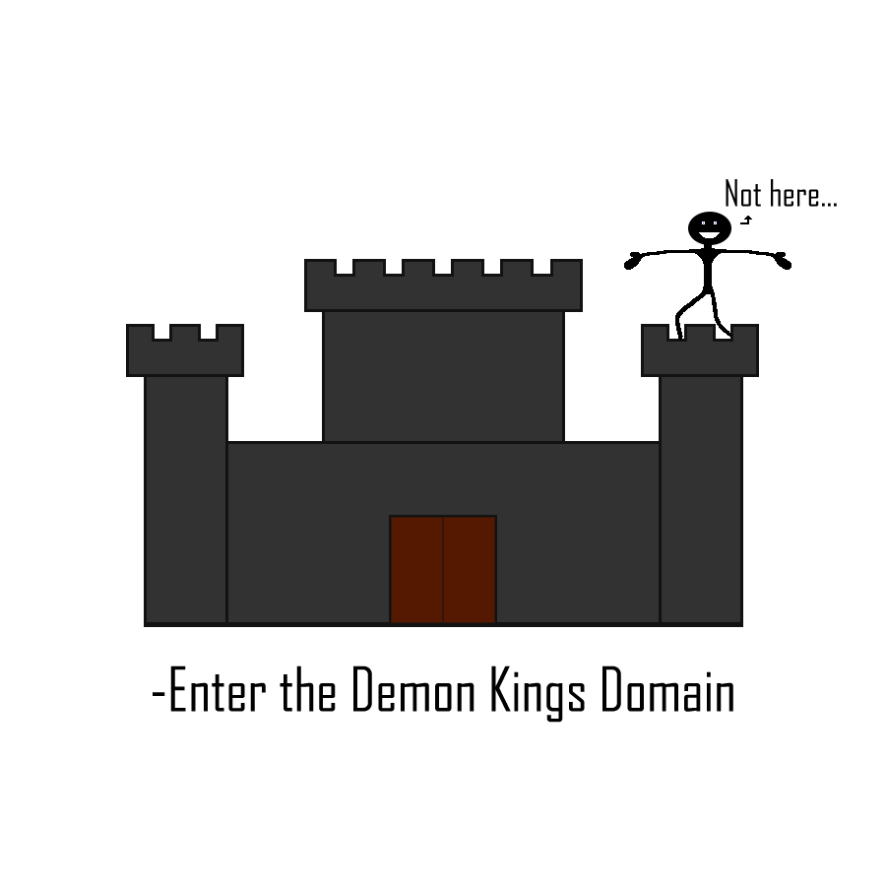
The Player

Slide 8
The Goal

Slide 9


The Goal

Slide 10
The Enemies

Slide 11
The Slime

Slide 12

The Slime

Slide 13
The Slime

Slide 14

The Slime-Tower

Slide 15
The Slime-Tower

Slide 16
The Game Flow

Slide 17
The Game Flow

Slide 18

The Game Flow

Slide 19
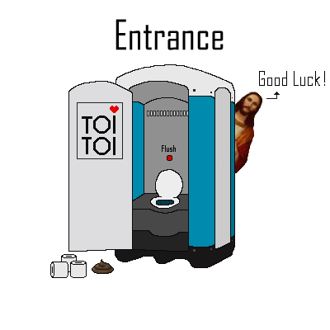
The Game Flow

Slide 20
The Game Flow

Slide 21
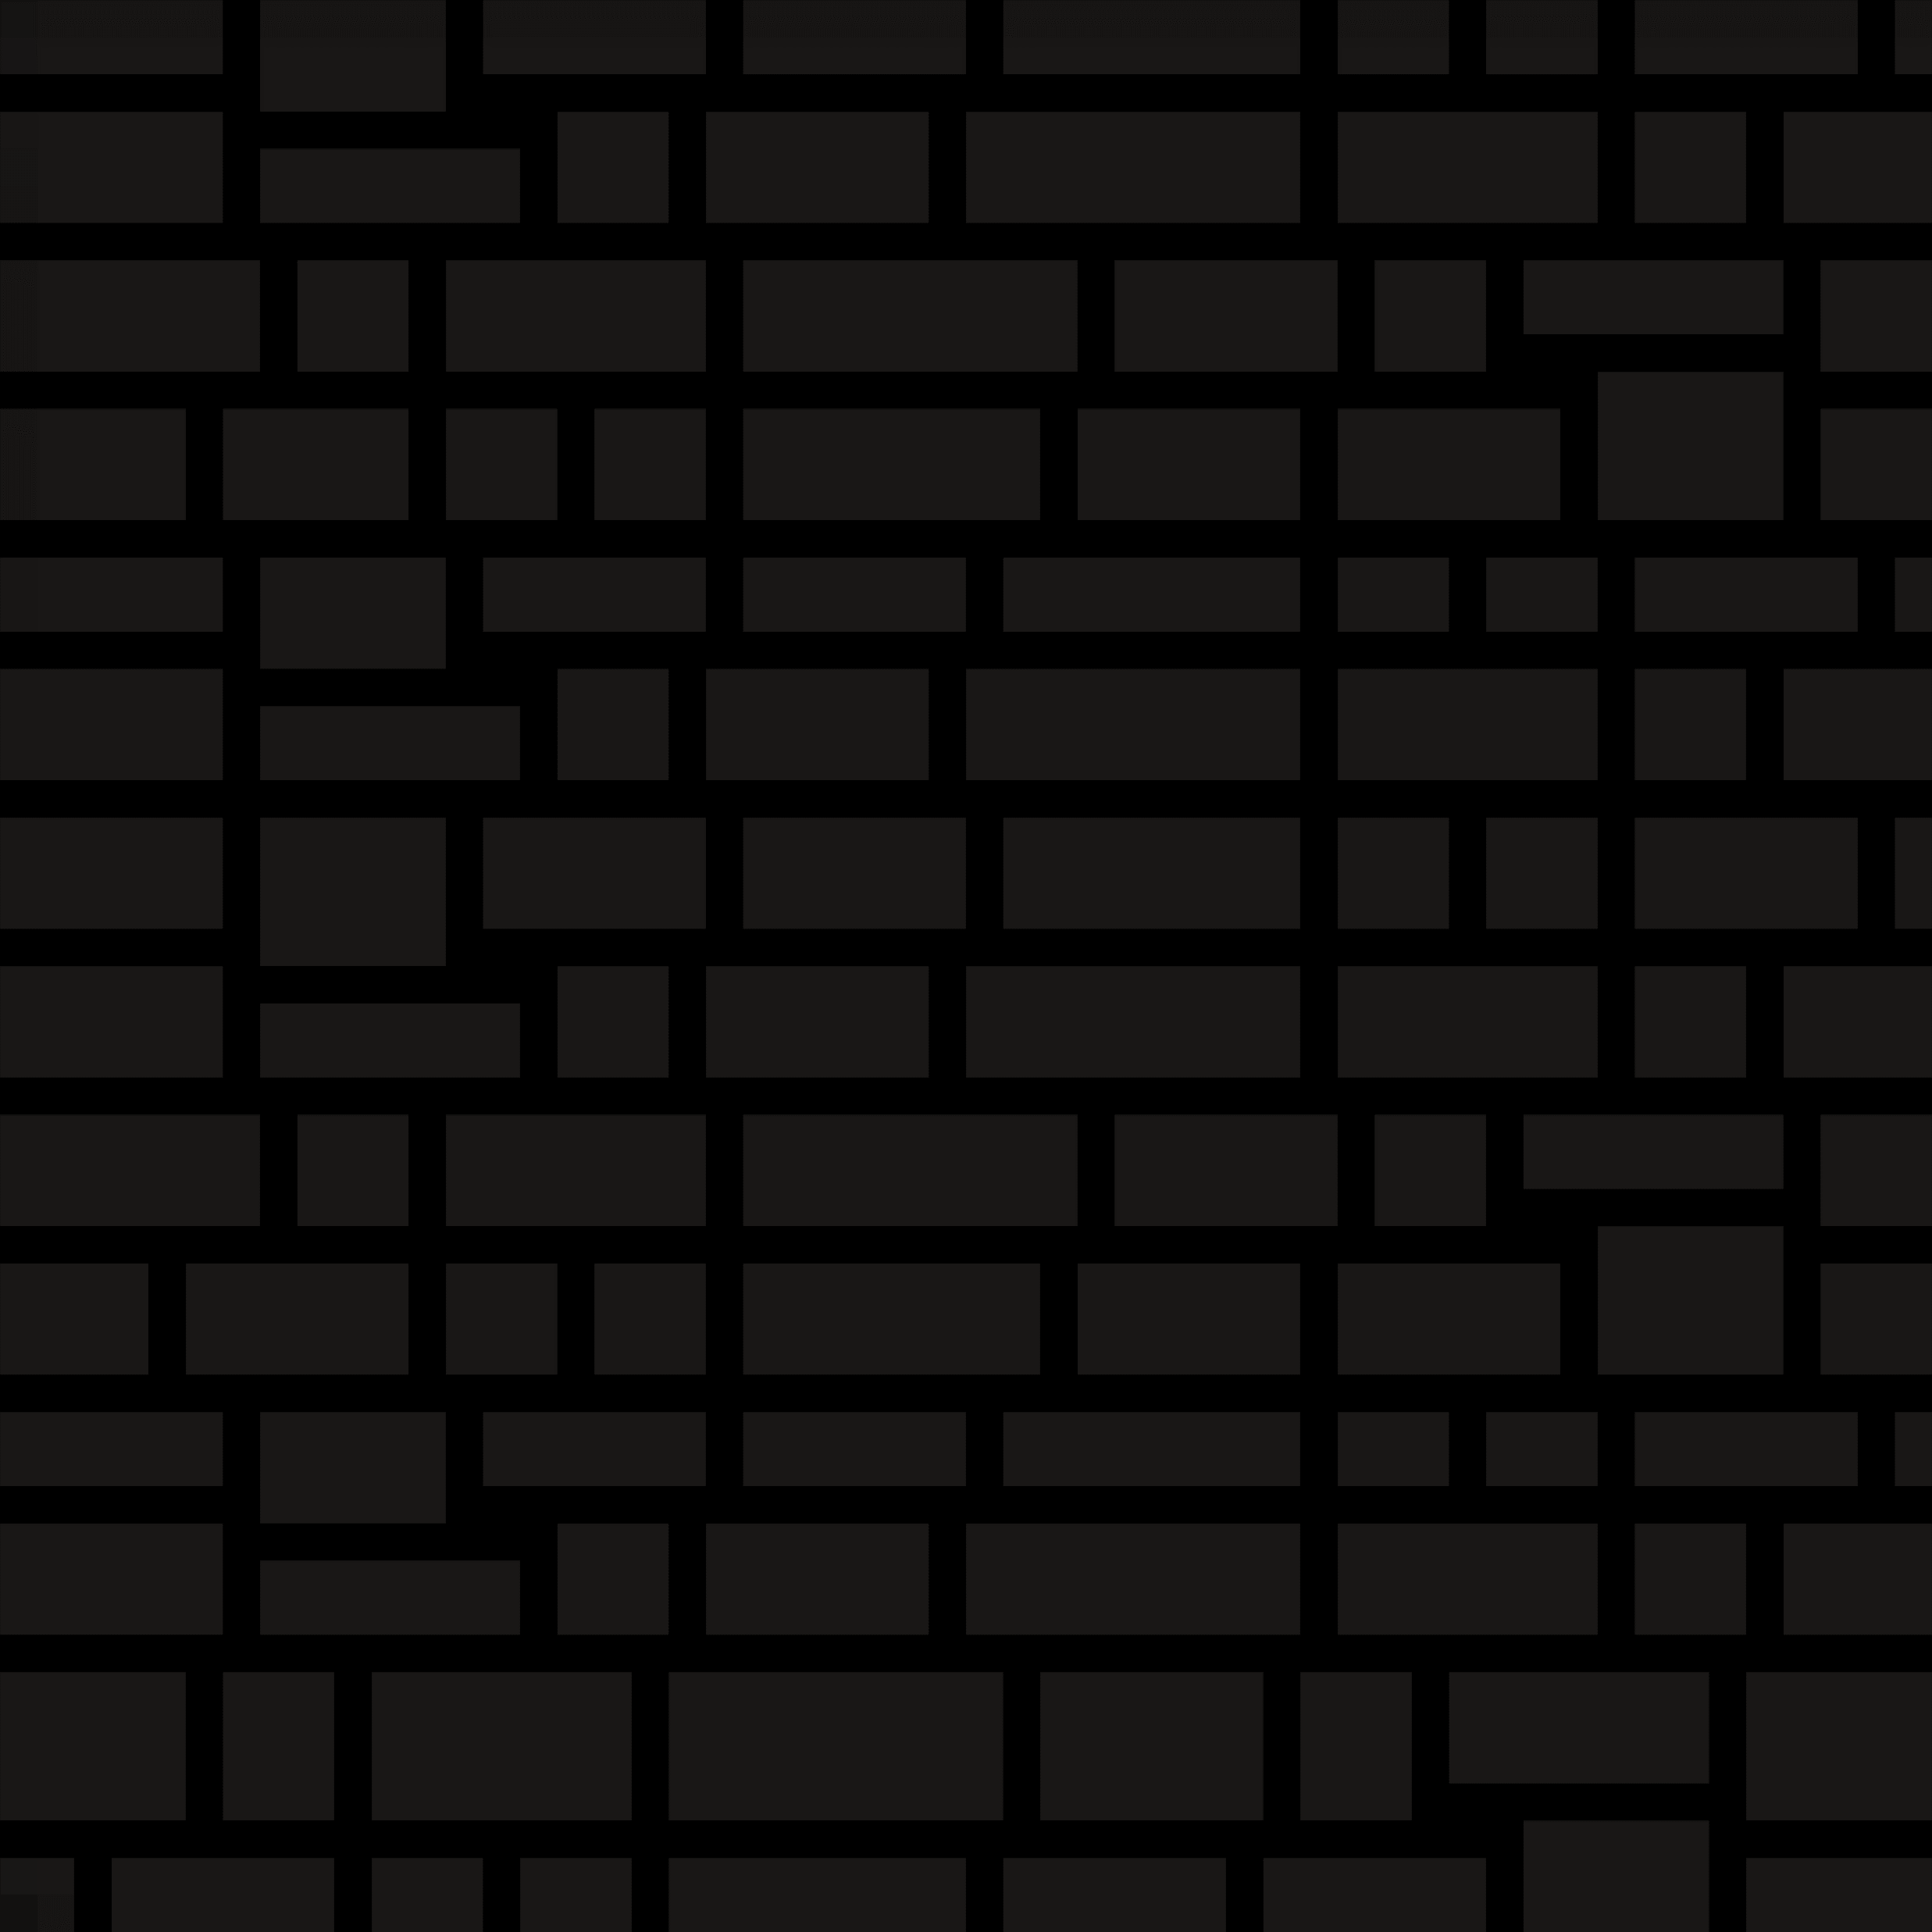

Slide 22
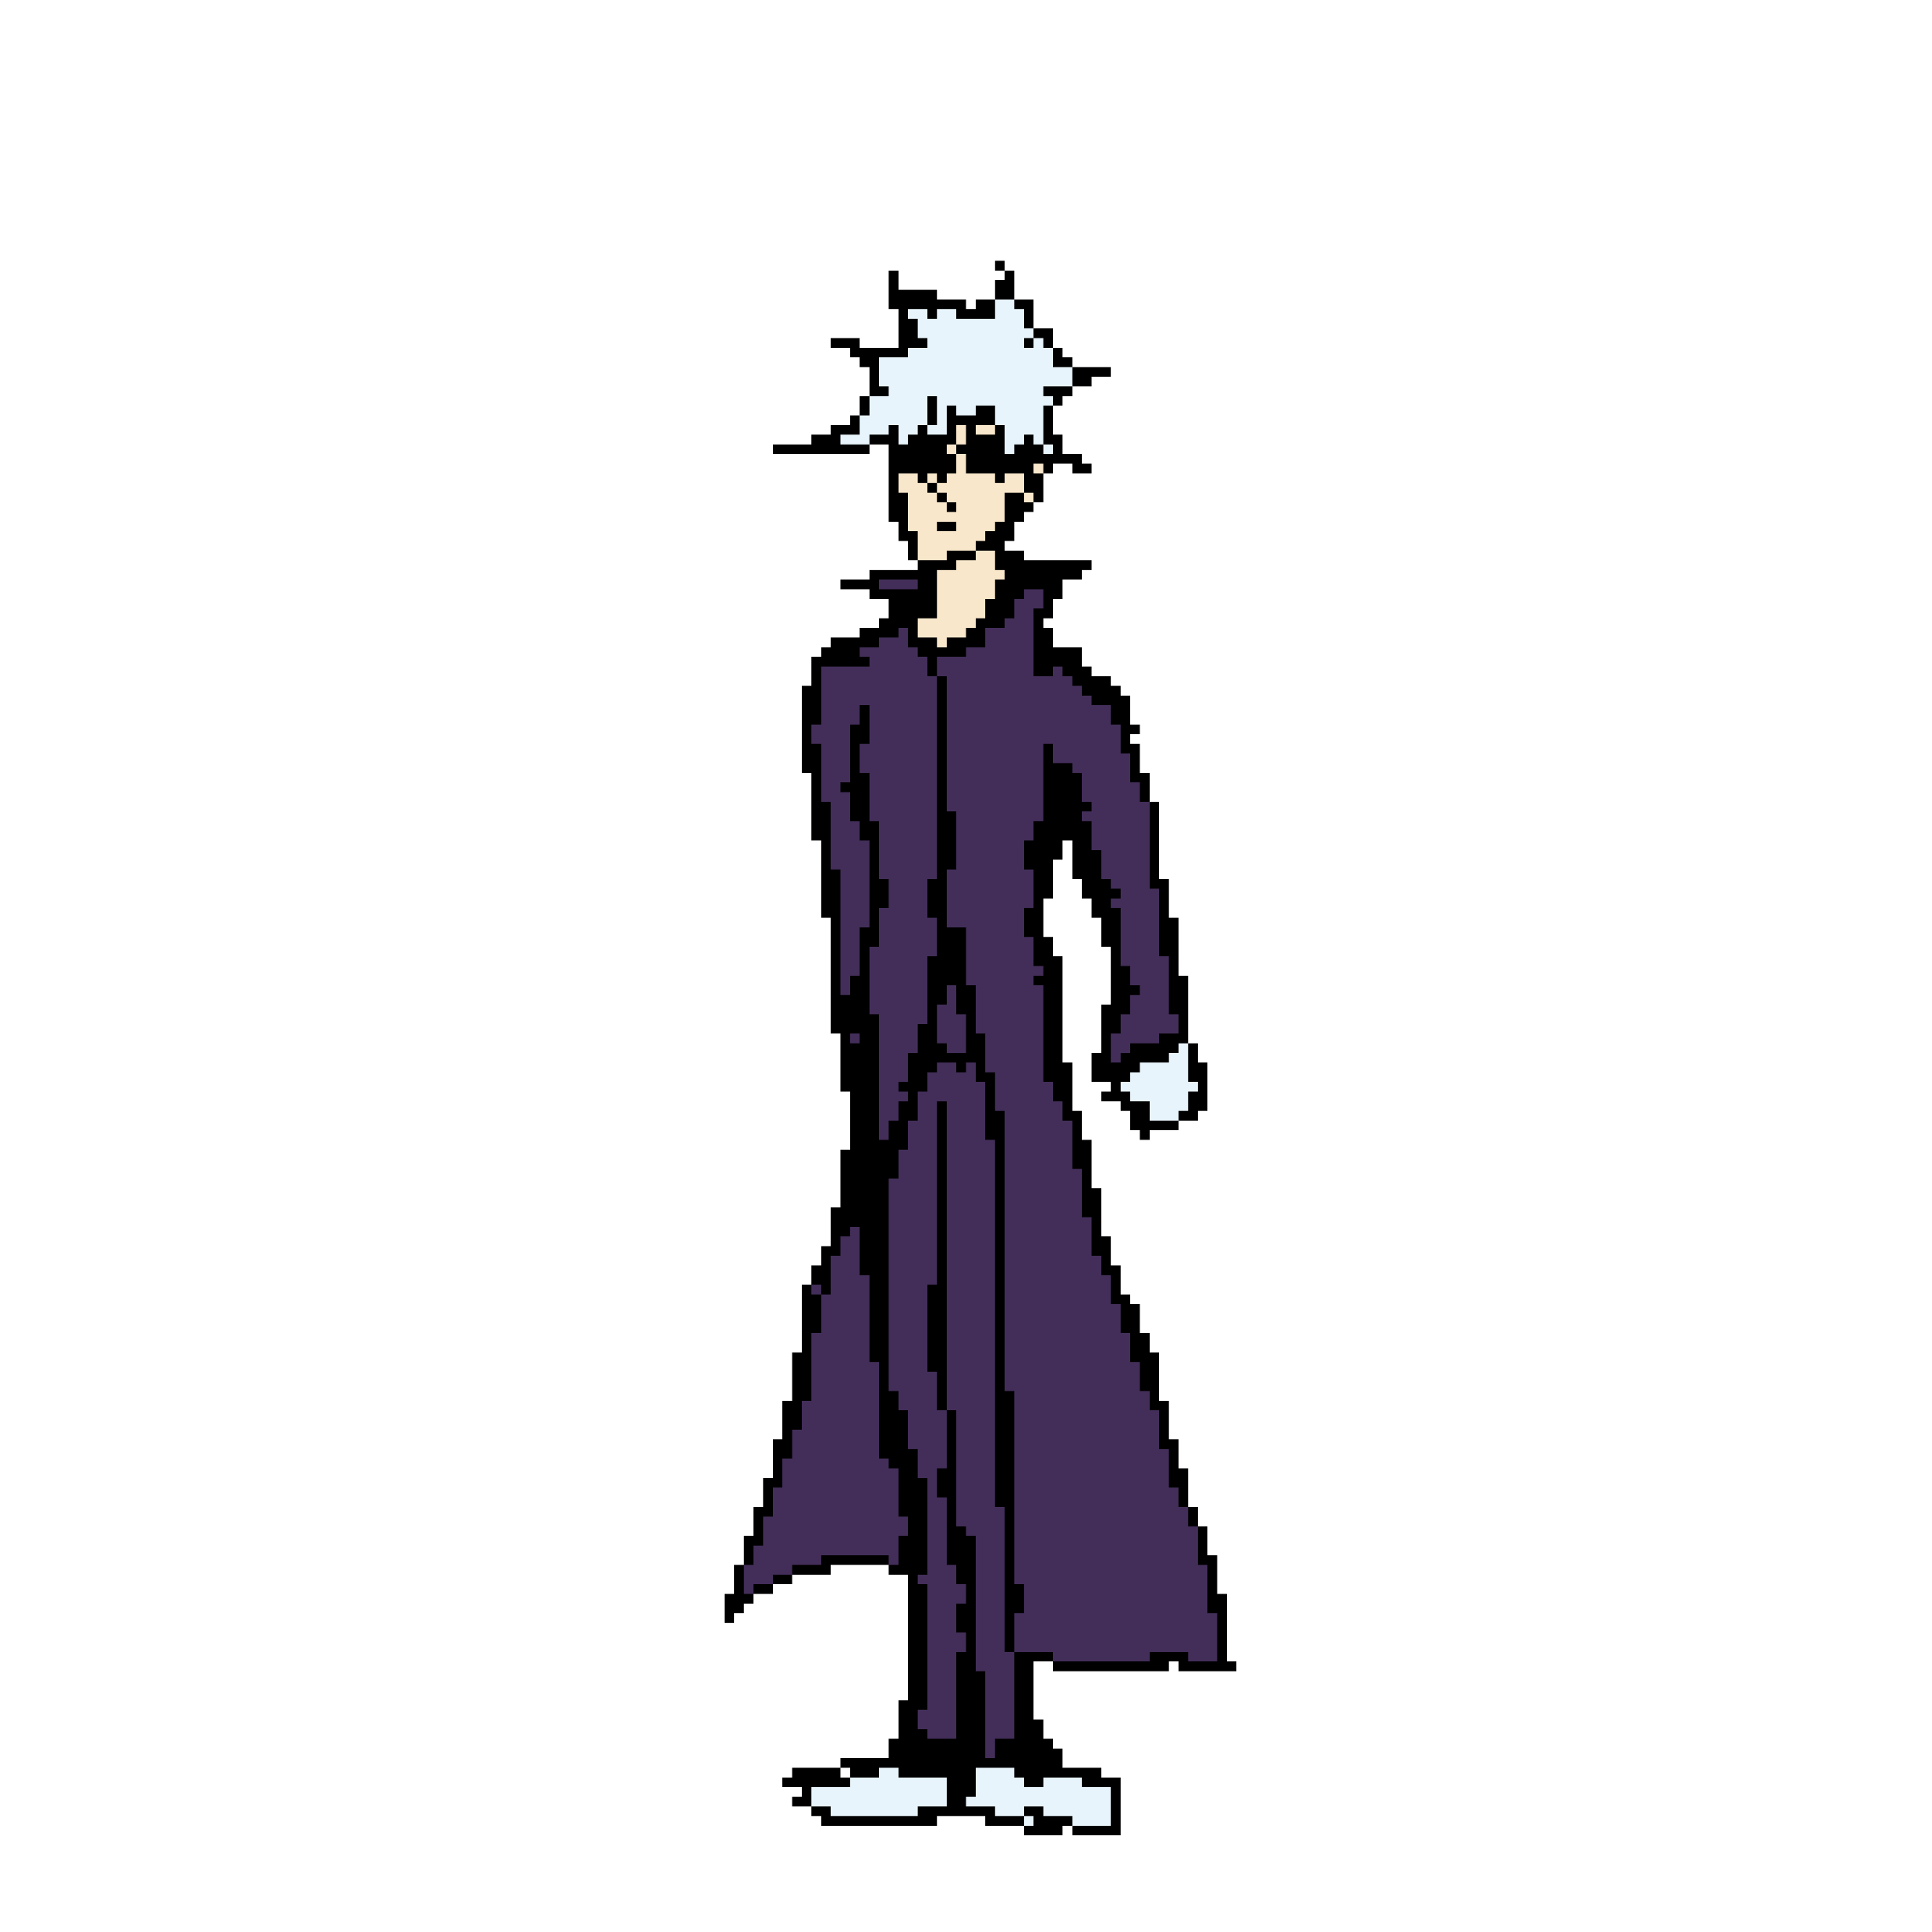
The Boss-Fight

Slide 23
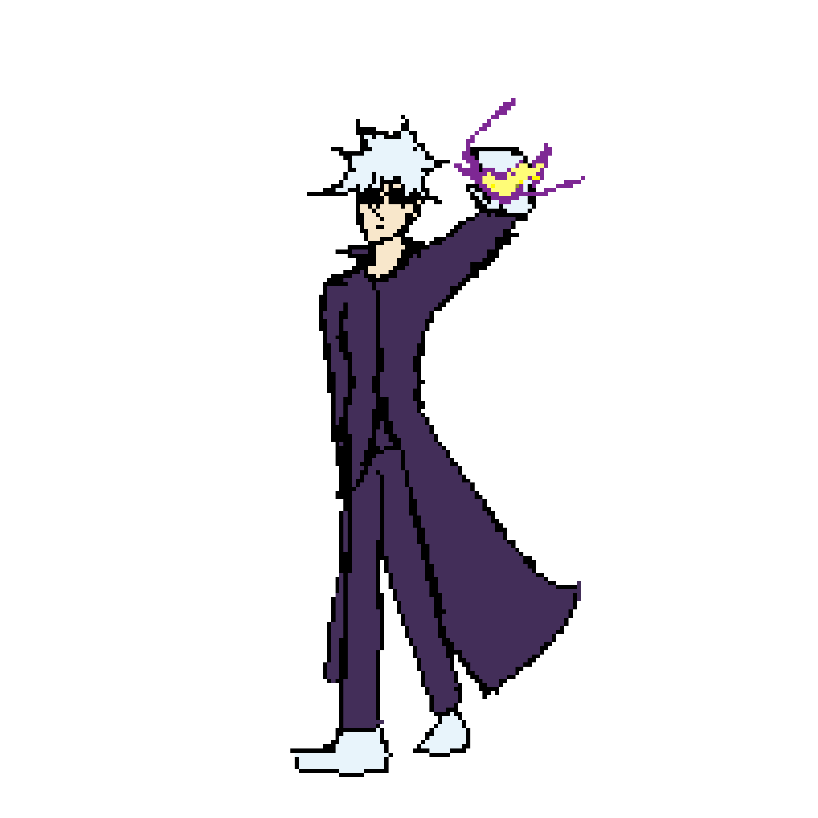

The Boss-Fight

Slide 24
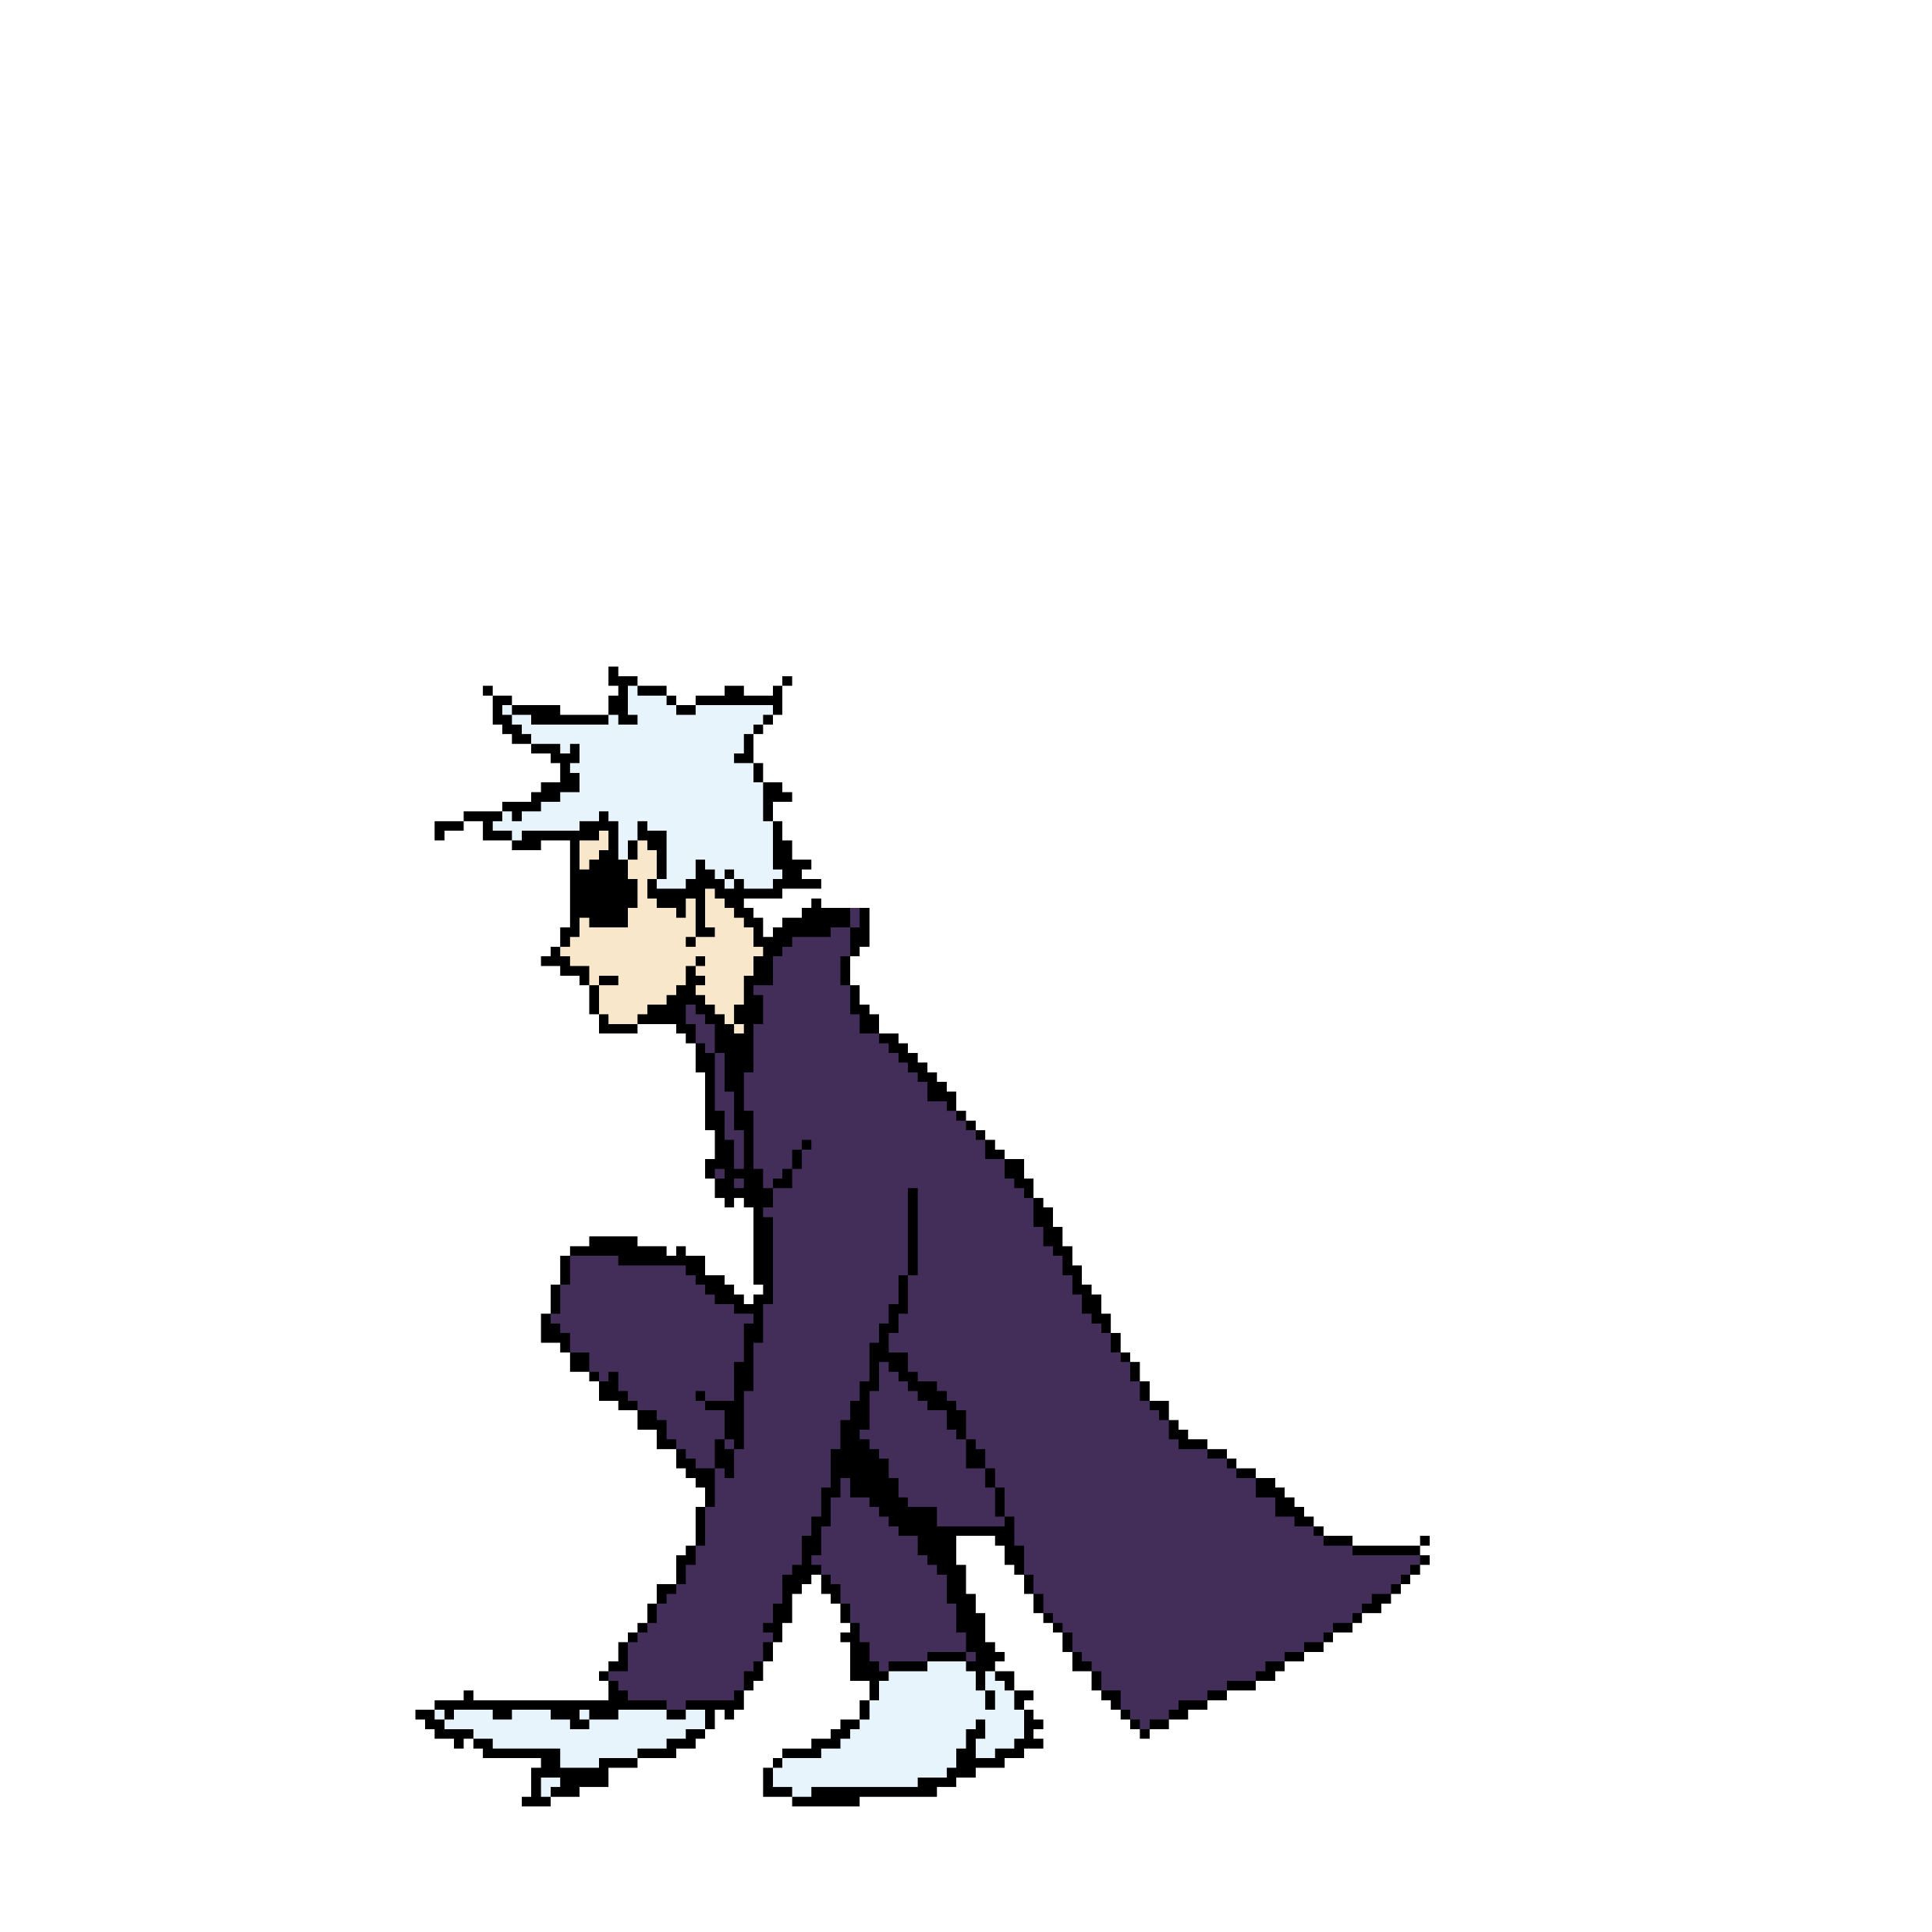
The Boss-Fight

Slide 25
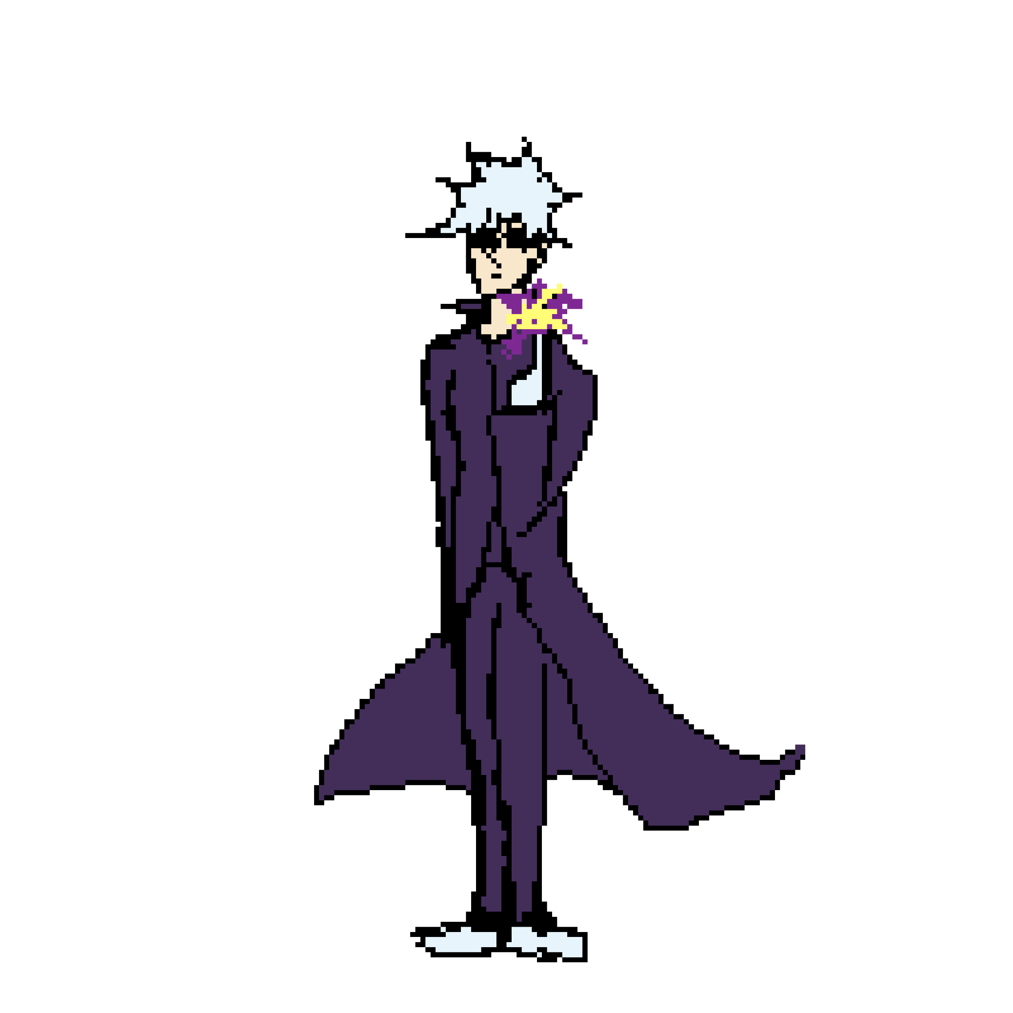

The Boss-Fight

Slide 26
The Boss-Fight

Slide 27
The Boss-Fight

Slide 28
VICTORY
Workflow

Slide 29
VICTORY
Glorious Morning 2 || Waterflame
進撃gt20130218巨人 || Hiroyuki Sawano
Jet Set Run || Yuki Hayashi
オール・フォー・ワンの力 || Yuki Hayashi
Levanta || S7VEN
Workflow

Slide 30
Glorious Morning 2 || Waterflame
進撃gt20130218巨人 || Hiroyuki Sawano
Jet Set Run || Yuki Hayashi
オール・フォー・ワンの力 || Yuki Hayashi
Levanta || S7VEN
Workflow

Slide 31
Thank you for your attention!
Glorious Morning 2 || Waterflame
進撃gt20130218巨人 || Hiroyuki Sawano
Jet Set Run || Yuki Hayashi
オール・フォー・ワンの力 || Yuki Hayashi
Levanta || S7VEN

